Slide 1
COMMUNITY ASSIST SYSTEM
Kaushal Chaudhary (001886763) Mohit ruke (001825190) Gauresh chavan (001854530)

Slide 2
Problem statement
Community’s reliance on an authoritative body
No resource available for good Samaritans to be socially helpful
A need for a centralized application that leverages potential of a community to help itself is rudimentary

Slide 3
approach
Providing comprehensive and exhaustive information for social service through an easily accessible and user-friendly application
Bridging the gap by connecting non-profit organizations and distributors to the community
Uplifting community by encouraging zesty volunteers to work for social causes set up by the NGOs

Slide 4

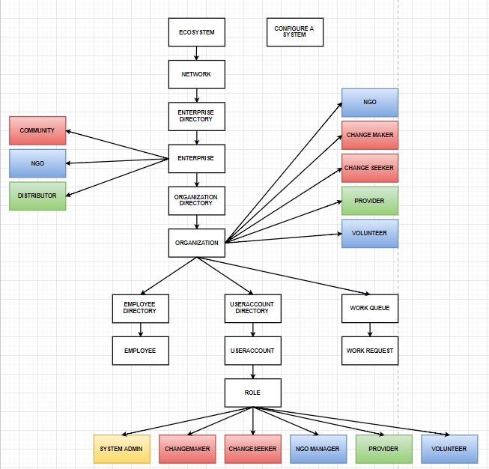
Object model

Slide 5
Use cases
Manage Community enterprise - create Change seeker - create Change maker
1
Manage NGO enterprise - create NGO manager - create social events - request for supplies from distributor
2
Manage Distributor enterprise - create supplier - supplier creates supplies - fulfill request from NGOs
3
Manage Volunteers - create volunteers - join an event of NGO
4

Slide 6
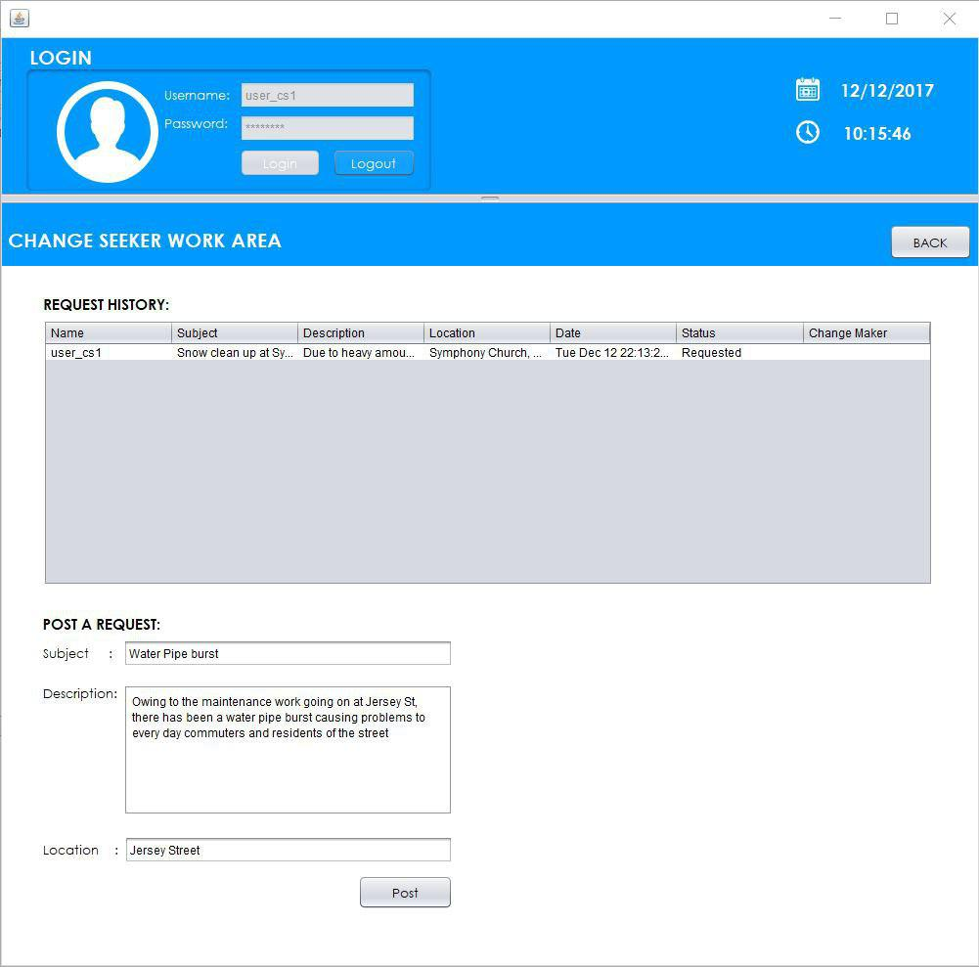
Change seeker posting a request

Slide 7
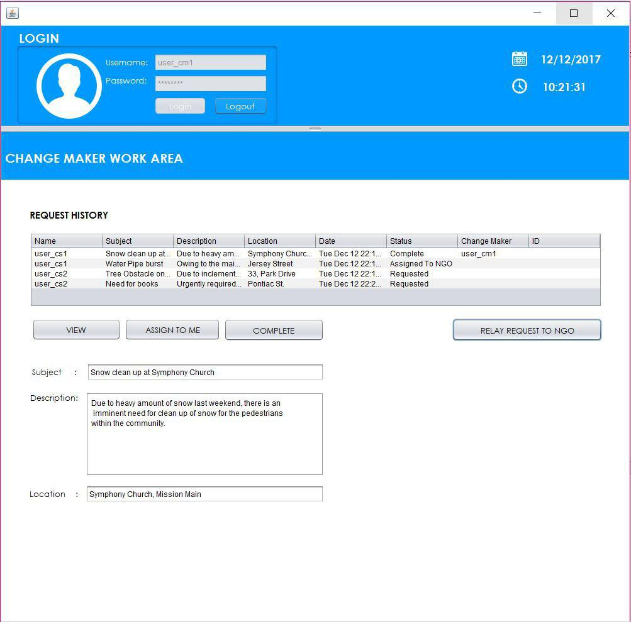
Change maker servicing request

Slide 8
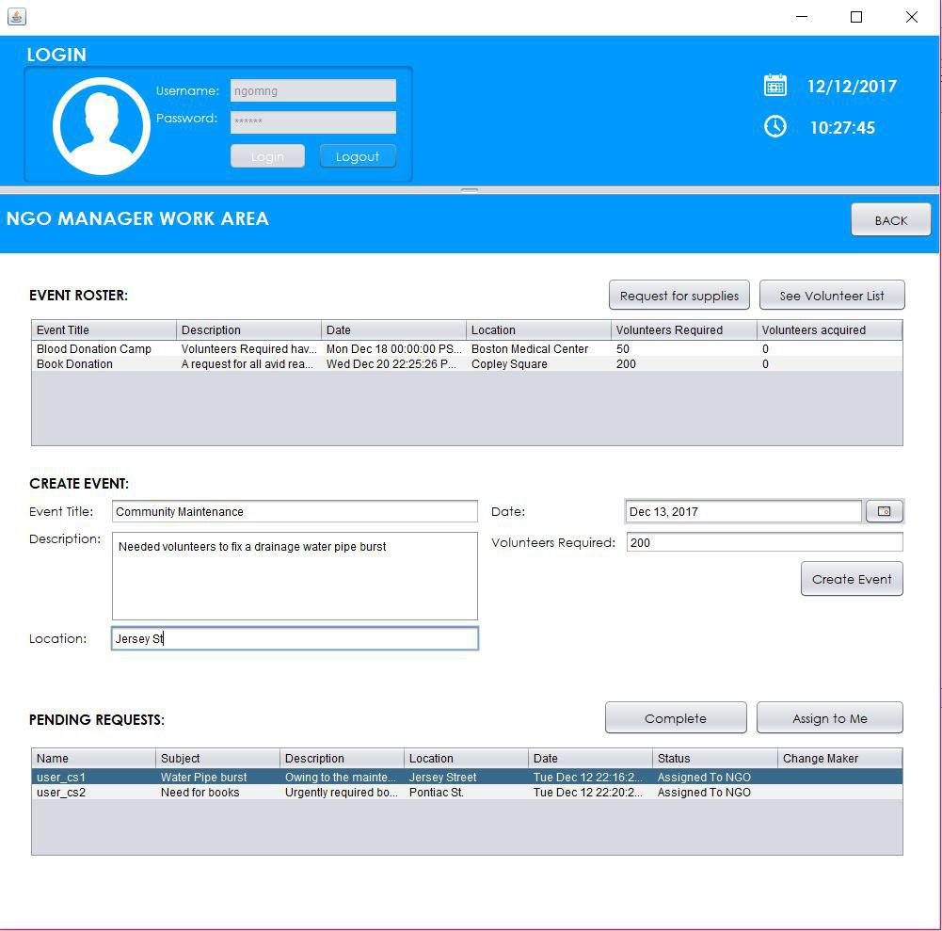
NGO creating an event

Slide 9
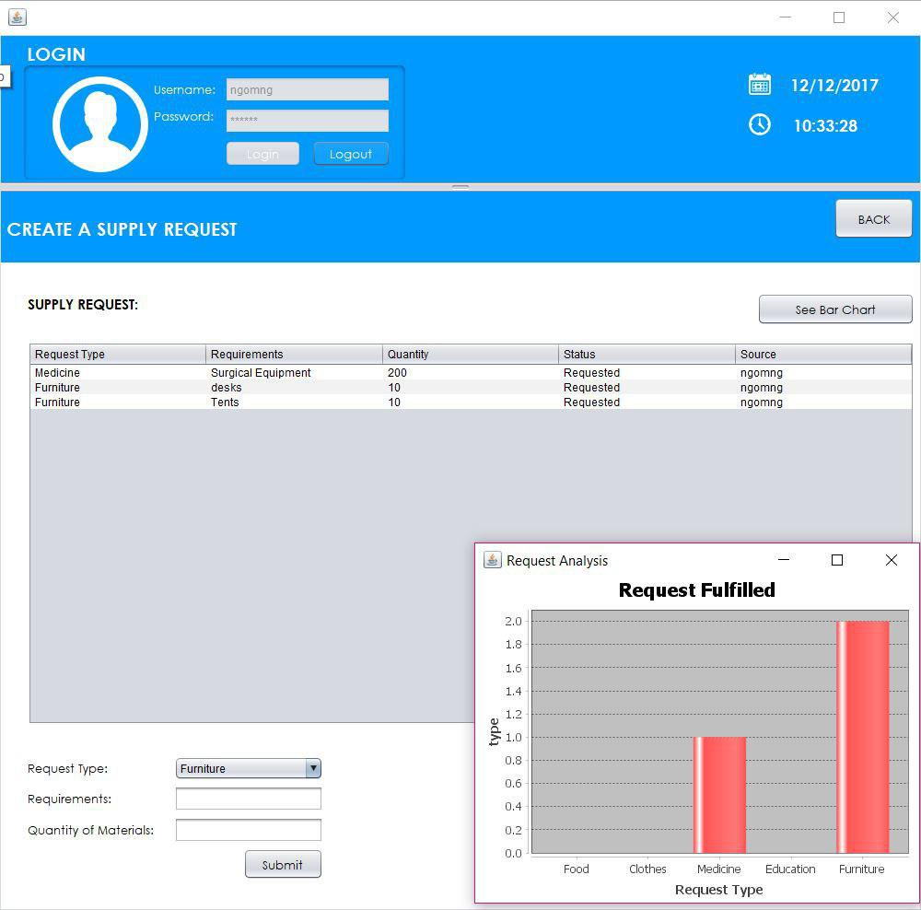
Ngo creates a request for supply

Slide 10
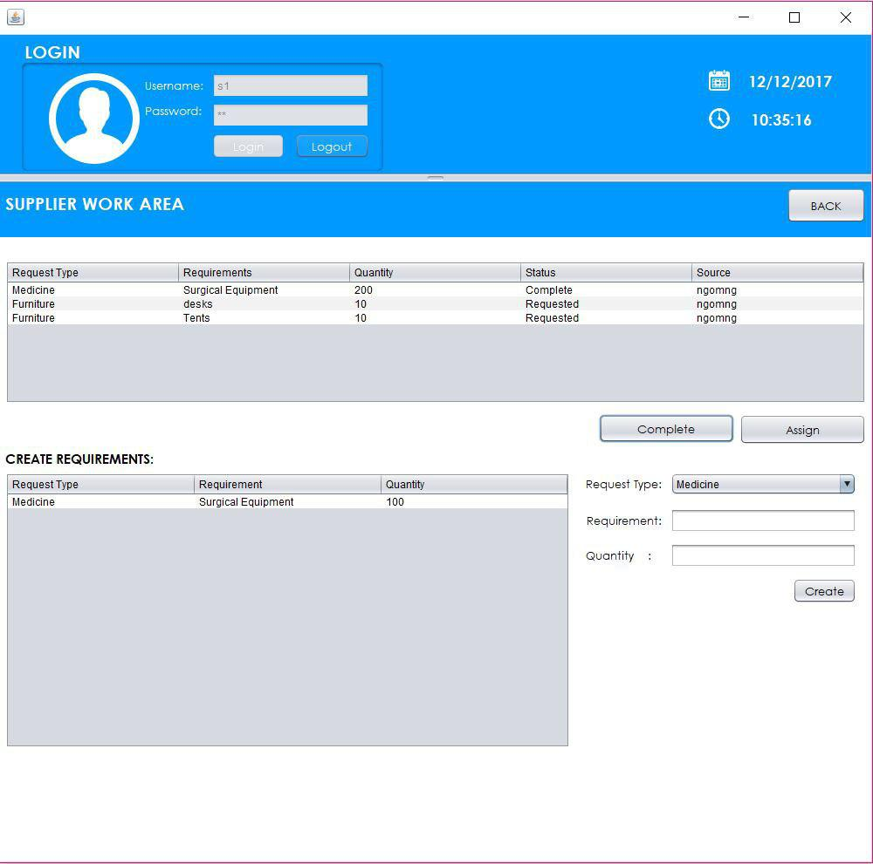
Distributor (supplier) servicing request from ngo by creating its own supply

Slide 11
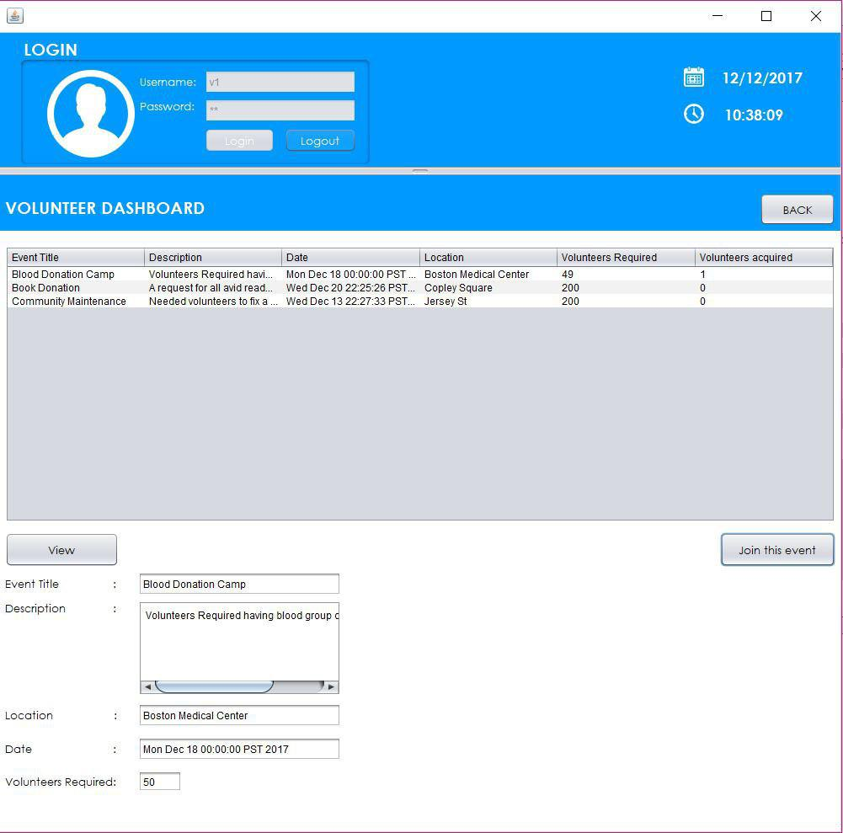
Volunteers registering for an event

Slide 12
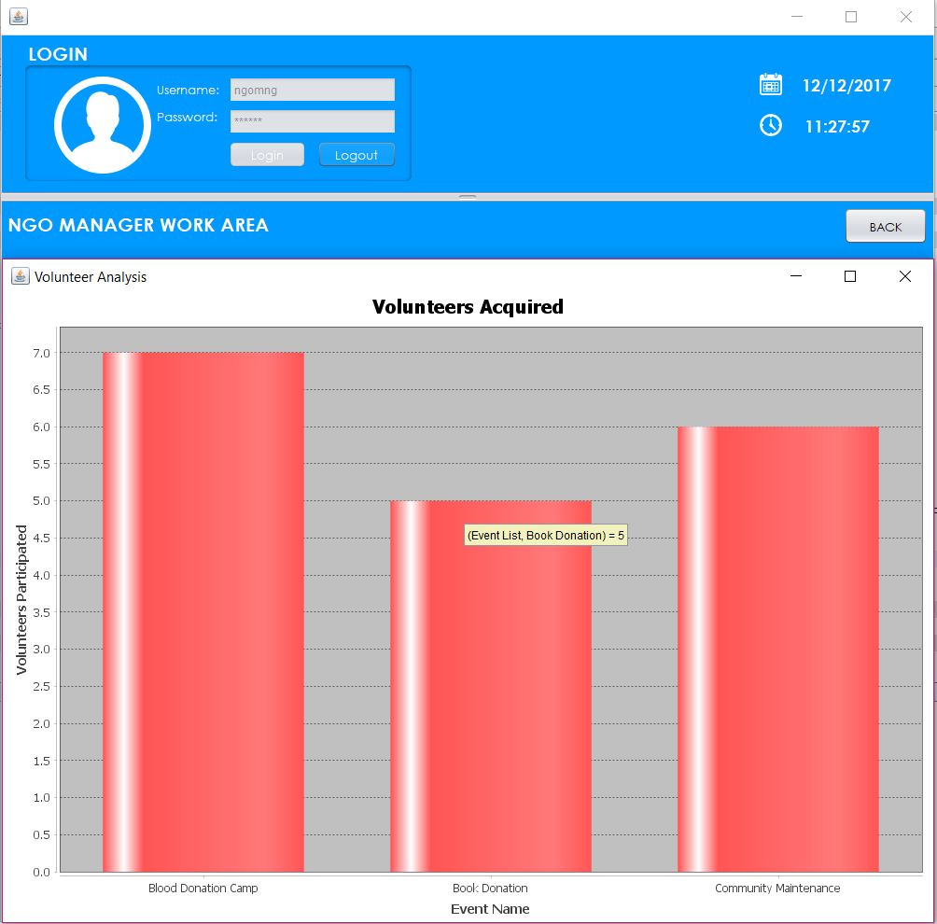
Volunteer analysis

Slide 13
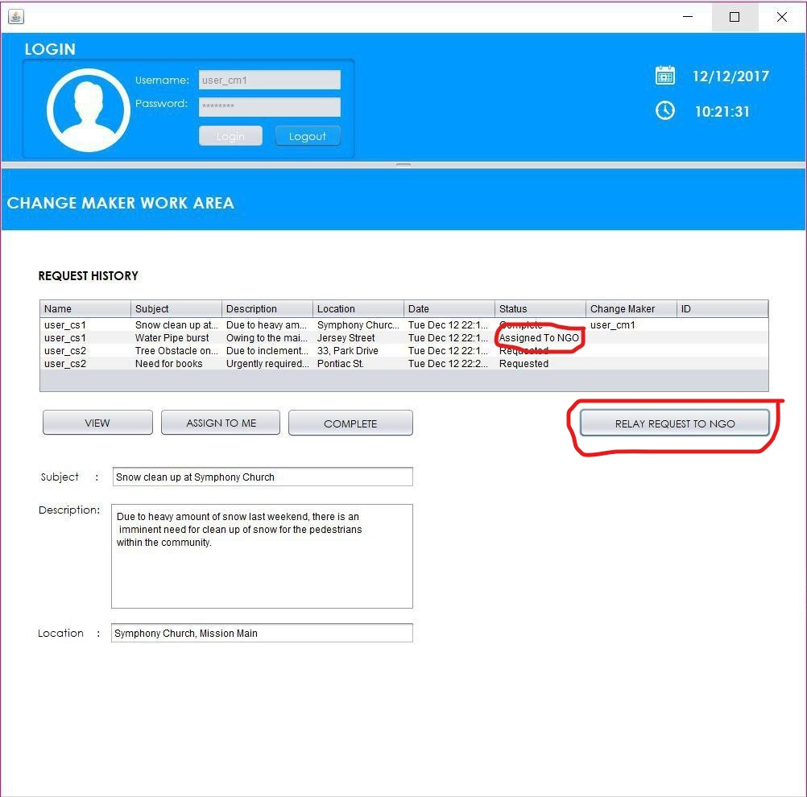
Change maker relaying request to ngo (In event where change maker cannot fulfill a request on his own)

Slide 14
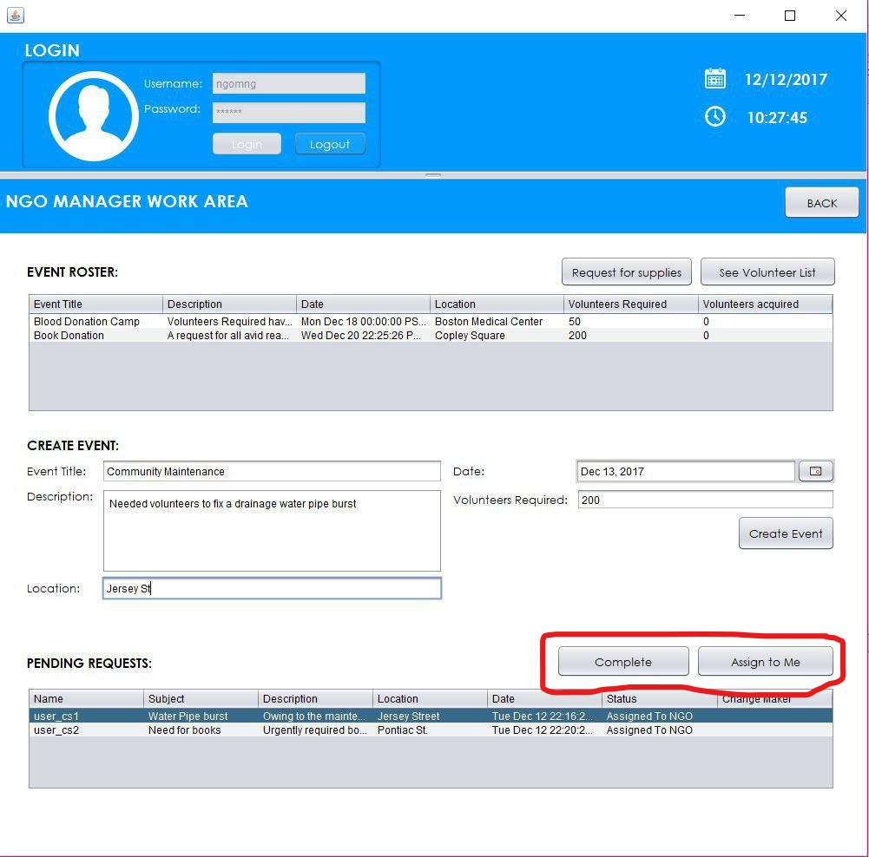
Ngo fulfilling a request from change maker

Slide 15
Task list
GAURESH (Project constitution: 33%) UI Analysis of data (bar charts) Documentation
KAUSHAL (Project constitution: 33%) Pojo classes Community enterprise use cases Distributor enterprise use cases
MOHIT (Project constitution: 33%) Object model NGO enterprise use cases Volunteer organization use cases

